Slide 1
Charter School Web Content Analysis

Slide 2
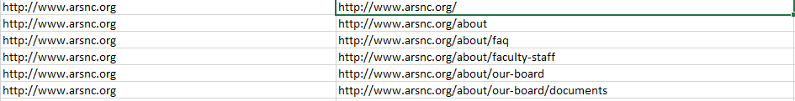
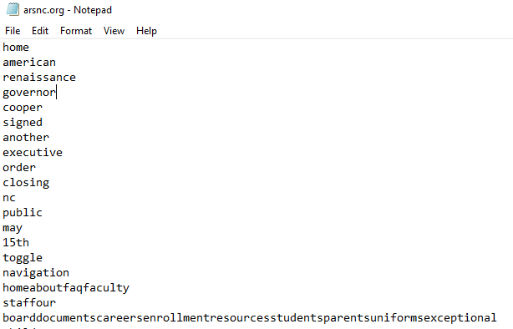
How did we obtain the data ?
Spyder – get me all the links you can from the given homepage
EXCEPTIONS - give me internal links, do not return outside links like facebook
Beautiful soup – get me all the words from the given link

Slide 3
How clean is the data?
Removing stop words – (“a”, “an”, “or”, “the”, “in”)
Remove numbers
Remove common words (‘school’ , ’student’, ’class’)
Remove any coding scripts existing in the content texts

Slide 4
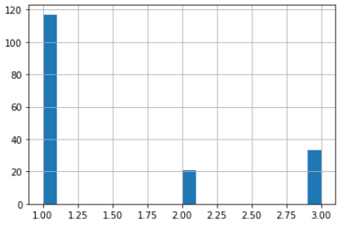
All data is not created equal
Poverty Levels by Frequency
1) There are more poverty level 1 than others, hence why the word count for Poverty Level 1 is greater.
2) How do we clean the data for poverty level 1 where it is not skewing our results
# of schools
Poverty Level

Slide 5
What kind of schools are in different poverty levels?
Main concern – Schools like Kipps (schools that are corporate) would saturate each individual word count because corporate marketing is about the same.
Do we have to worry? – I have to get the list of binary info

Slide 6
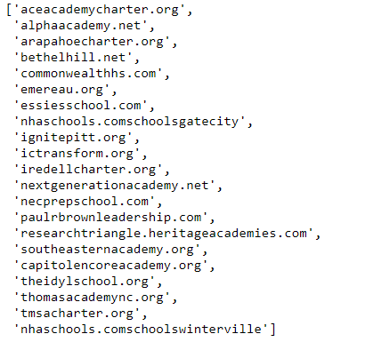
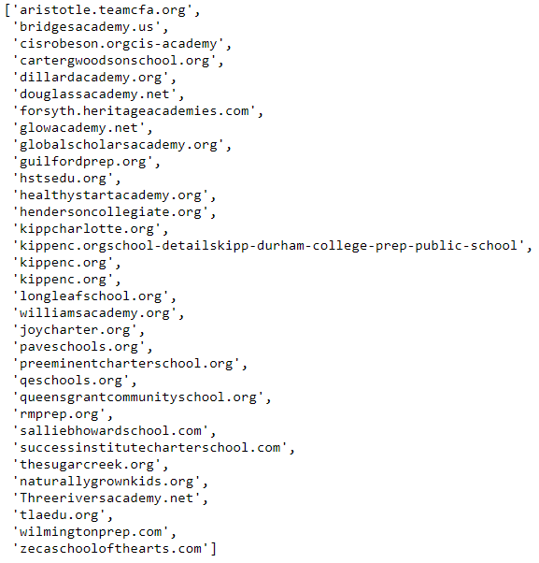
Corpus text in each poverty level
Poverty Level 2
Poverty Level 3

Slide 7
Main Take Aways
What are the list of corporate school
What other analytical tools can we use on the corpus?

